Slide 1
Fast mmWave RF 3D-Object Reconstruction in Low-Visibility Environment via UAV Platform Final Product Presentation 05/14/2021
Team 4
Customer Mentor/Technical Manager:
Dr. Honggang Zhang
Zhuoming Huang(Senior)
Alinson Sanquintin(Junior)

Slide 2
Technical Manager/ Customer Mentor:
Dr. Honggang Zhang
Basic team members:
Zhuoming Huang
Collects and synthesizes radar and camera sensor data for model training.
Subsystem tests and analyses.
Drone development
Alinson Sanquintin
Creates CAD models and converts them into point-cloud format.
Subsystem tests, assists with SAR experiments and data processing.
External team members:
Yue Sun
Builds Neural Networks to train AI models and generate 3D radar intensity maps/2D depth images.
Lucas Lomba
Helps with PCB design and UAV development
Communication Plan
Weekly meetings: Zoom
File sharing: GitHub, Google Drive
Project management: MS Project
Team Introduction

Slide 3
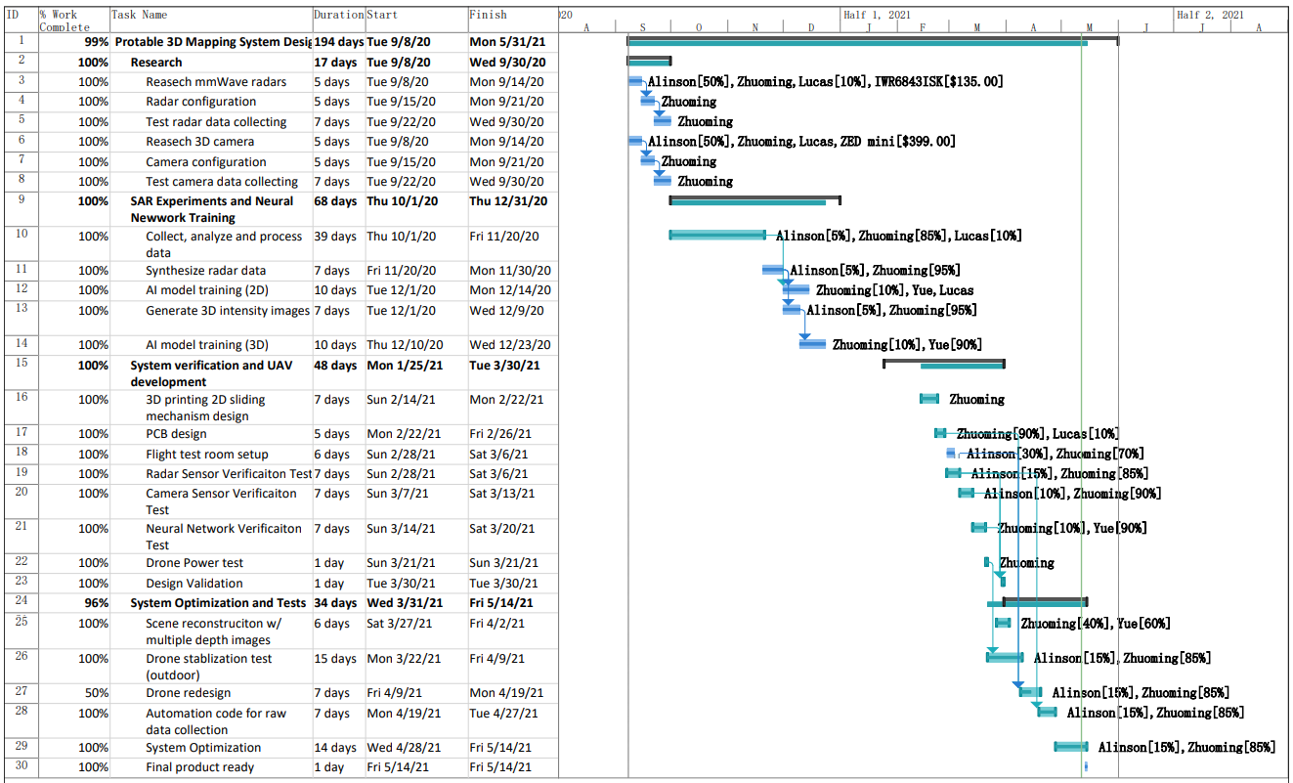
Project Management

Slide 4
Motivations:
Unsafe to access unknown and high-risk areas (smoke, fog, low-visibility) for explorations or rescues [1][2]
Difficult to implement non-intrusive and privacy-preserving monitoring for public health and safety.
Managements of large-scale facilities need plenty of resource (time or labor) in traditional ways.
Application of mmWave radar sensors in autonomous driving.
UAV can move in a 3D space with high efficiency and flexibility.
Problem Definition
Requirements:
Capability to outline the shape of an object in a 3D space
Accurately estimates the position of an object
An UAV platform holding and moving the sensors
Low cost, and simple operations

Slide 5

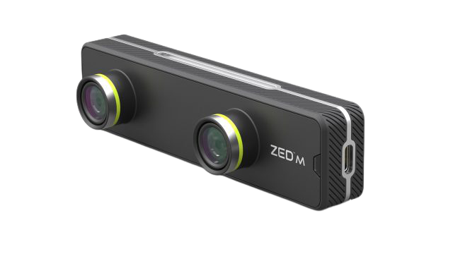
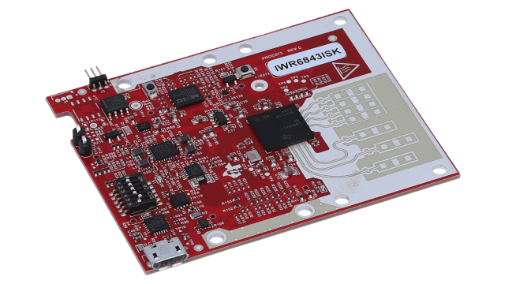
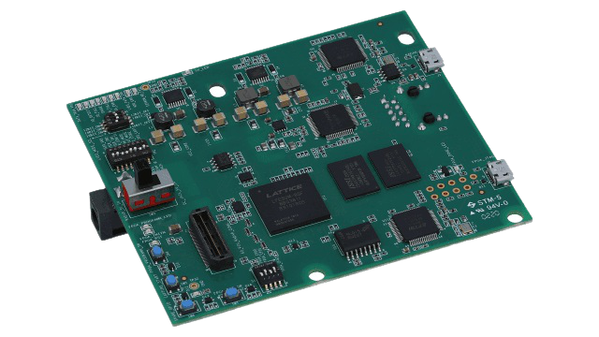
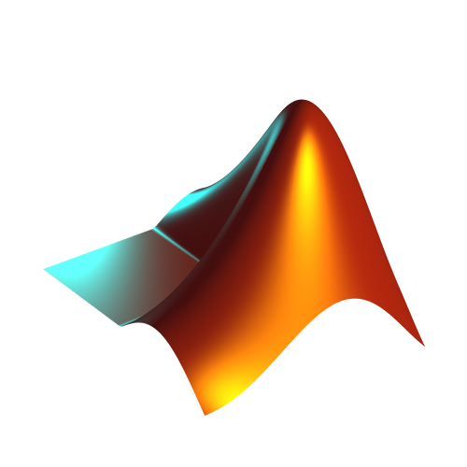


System Architecture
Stage 1
ZED mini [5]
Stage 2
Stage 3
Radar sensor configuration
Depth camera
Drone
TI’s IWR6843ISK [3]
TI’s DCA1000EVM [4]
Customized
2D slider
mmWave FMCW
radar sensor
Data capture card
2D Depth Images
mmWave Studio
MATLAB
FreeCAD
Python
mmWave FMCW
radar sensor
Real radar signal
Full-scale 3D intensity maps
Ground truth
64x24
2x24
Full-scale raw data
Heatmap Generator
2-snapshot raw data
2-snapshot raw data
Heatmap Generator
Neural Networks
2-snapshot 3D intensity maps
Heatmap Generator
Hardware
Synthesized radar signal
2-snapshot 3D intensity maps
Software
Radar Signal Synthesizer
Model Training
Input/
Output
Point cloud-to-Depth image Generator
Trained
AI models
3D physical point cloud
Full scale 3D intensity maps/2D depth images
CAD-to-Point cloud Conversion
CAD models

Slide 6
System Architecture
Stage 1
ZED mini [5]
Stage 2
Stage 3
Radar sensor configuration
Depth camera
Drone
TI’s IWR6843ISK [3]
TI’s DCA1000EVM [4]
Customized
2D slider
mmWave FMCW
radar sensor
Data capture card
2D Depth Images
mmWave Studio
MATLAB
FreeCAD
Python
mmWave FMCW
radar sensor
Real radar signal
Full-scale 3D intensity maps
Ground truth
64x24
2x24
Full-scale raw data
Heatmap Generator
2-snapshot raw data
2-snapshot raw data
Heatmap Generator
Neural Networks
2-snapshot 3D intensity maps
Heatmap Generator
Hardware
Synthesized radar signal
2-snapshot 3D intensity maps
Software
Radar Signal Synthesizer
Model Training
Input/
Output
Point cloud-to-Depth image Generator
Trained
AI models
3D physical point cloud
Full scale 3D intensity maps/2D depth images
CAD-to-Point cloud Conversion
CAD models

Slide 7
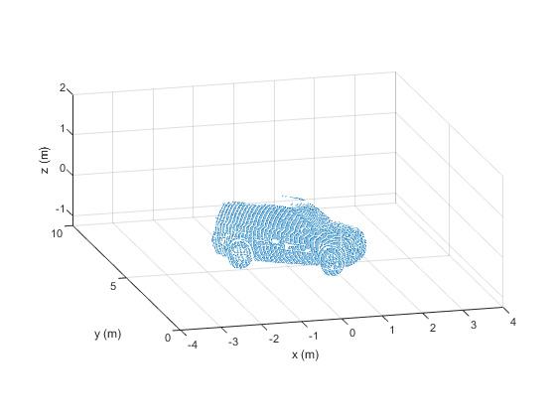

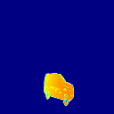
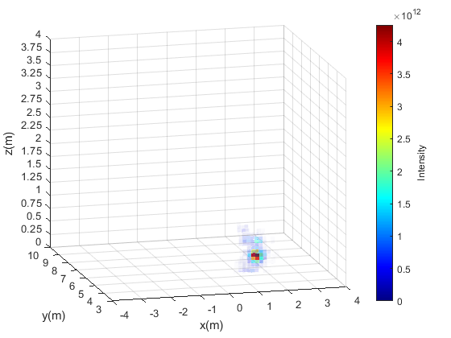
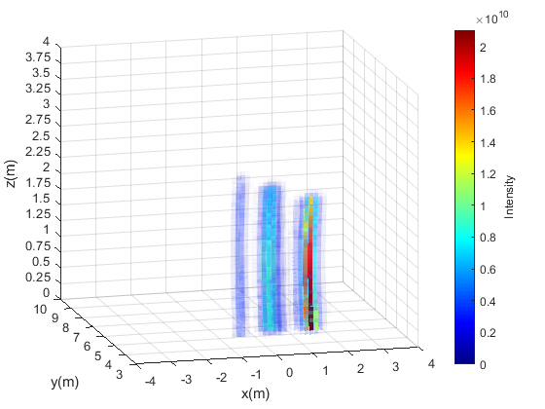
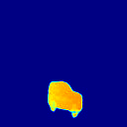
System Architecture
Example using CAD car models [1]
Original surface in point cloud (single view)
Reconstructed surface in point cloud
(single view)
True 2D depth image
3D radar intensity maps in Cartesian
(full scale)
Reconstruction
Neural Network
AI-generated 2D depth image
Trained AI model
(2 snapshots)

Slide 8
Final Budget
Pre-owned
Have purchased
Newly added
One time use
Plan to order
# | Item | Qty | Unit Price | Cost | Description | Status
1 | IWR6843ISK | 1 | $135.00 | $135.00 | mmWave radar sensor | Purchased
2 | ZED mini | 1 | $399.00 | $399.00 | 3D depth camera | Purchased
3 | T6x1-200mm Ball Screw Slide | 4 | $70.00 | $280.00 | For moving the radar sensor horizontally/ vertically in SAR experiments only | Purchased
4 | Arduino Uno | 1 | $23.00 | $23.00 | Slider control | Purchased
5 | Adafruit motor shield | 1 | $19.95 | $19.95 | Motor driver | Purchased
6 | DCA1000EVM | 1 | $499.00 | $499.00 | Raw data capture card, for experiments only | Owned
7 | Customized small 2D sliding mechanism | 1 | N/A | $25 | For forming an SAR on a drone, including 3d-printed parts, timing belts, stepper motors | Purchased
8 | T-slotted rails | 2 | $20.00 | $40.00 | Frame that holds ball screw sliders and radar sensors for SAR experiments | Purchased
9 | OSHPARK PCBs | 1 | $20.80 | $20.80 | Deck connectors | Purchased
10 | Wurth Elektronik FFC connector | 10 | $1.33 | $13.30 | To be used on PCBs | Purchased
11 | Jetson Nano | 1 | $99.00 | $99.00 | Computing unit on drone | Owned
12 | Jetson Nano cooling fan | 1 | $13.70 | $13.70 |  | Purchased
13 | Crazyflie set | 1 | $327.00 | $327.00 | Flight control, including Crazyflie v2.1, BigQuad deck, flow-v2 deck, and multi-ranger deck | Owned
14 | 5V, 2.5A power cable | 1 | $10.00 | $10.00 |  | Purchased
 | Total |  |  | $1714.75 | Data collecting + UAV sensing equipment
 | Used budget |  |  | $979.75 | Out of the $1000 budget
 | Final product estimated budget |  |  | $965.80 | UAV sensing equipment

Slide 9
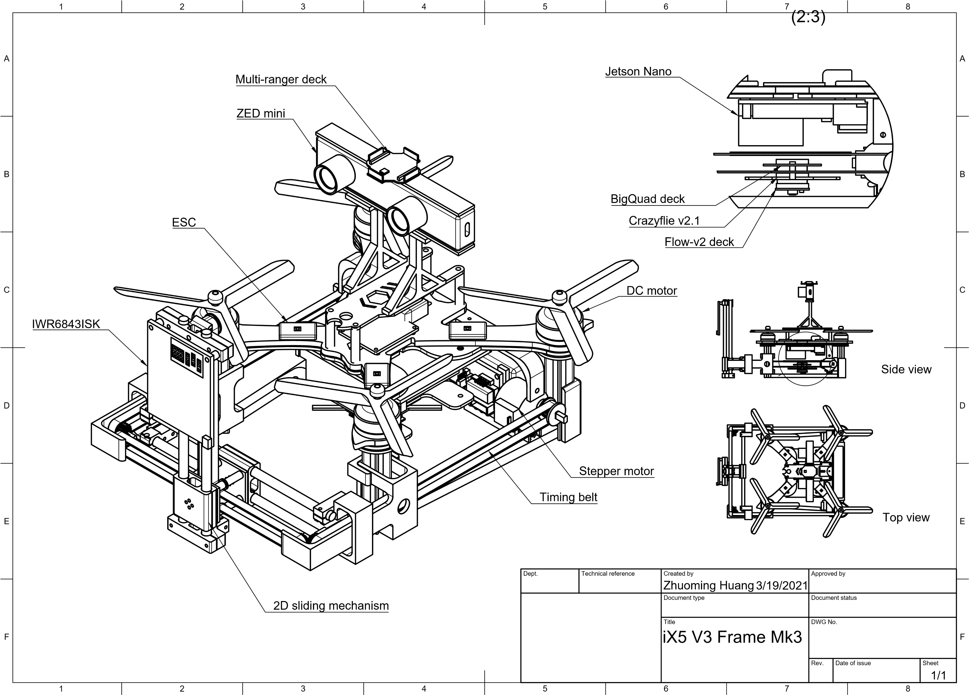
Drone Design
Dimension: 285 x 300 x 160 mm
Weight: 930 g
*Fusion 360

Slide 10
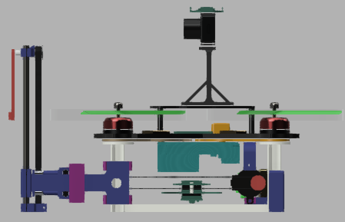
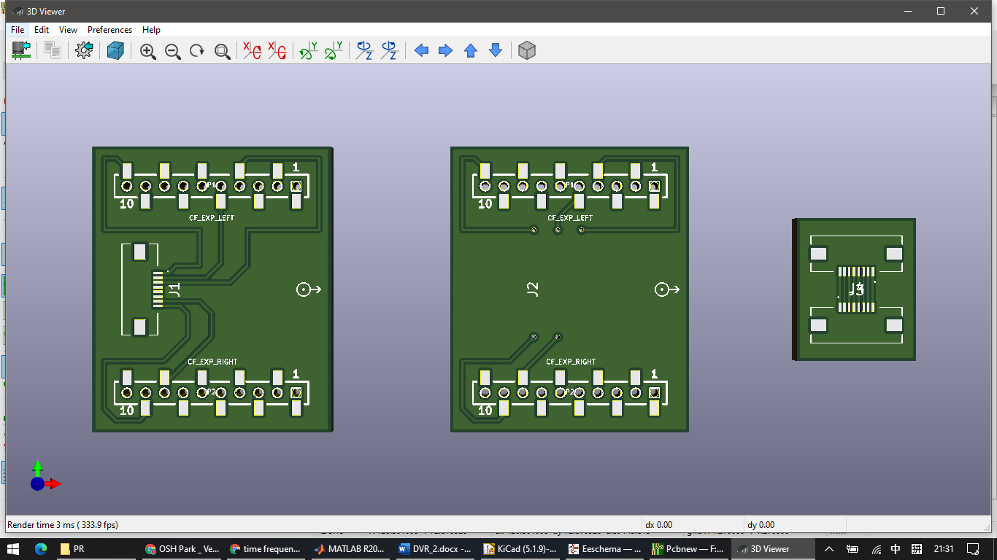
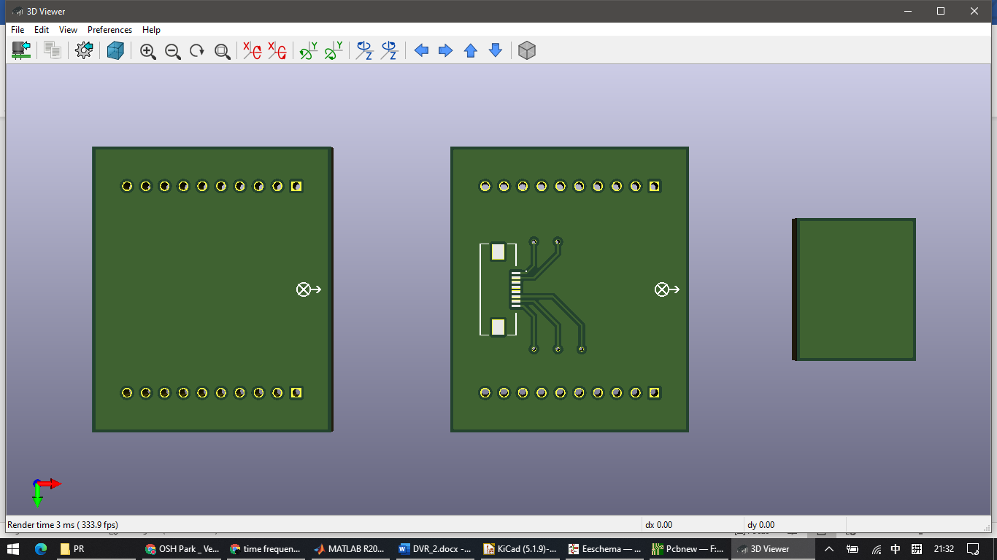
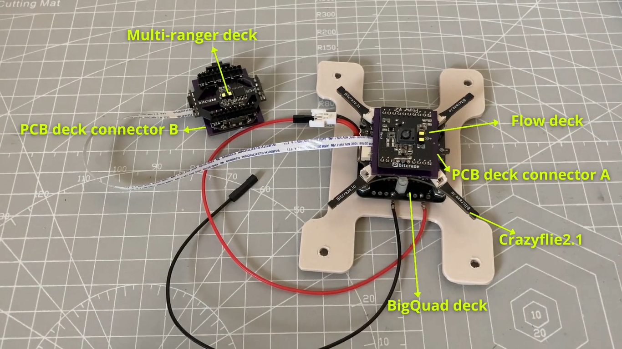
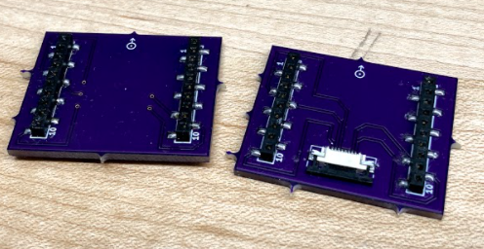
PCB Design
PCB deck connectors:
A pair of deck connectors with an FFC cable are specifically used to connect the Multi-ranger deck on the top to the other Crazyflie components (e.g., Flow-v2 deck) at the bottom of the drone.
(Measures distance to ceiling and surrounding)
(Measures distance to the ground)
Deck connector A (front/back)
Deck connector B (front/back)
Flexible Flat Cable (FFC)

Slide 11
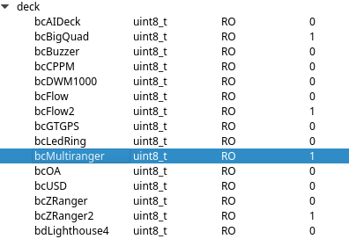
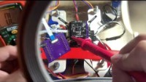
PCB Test
Connection test:
Check if FFC connectors are successfully soldered, and if pins are correctly connected.
Result:
Multi-ranger deck is recognized by Crazyflie PC client. No error was reported. All decks are fully functioning together.
https://youtu.be/XsmHnefhABg

Slide 12
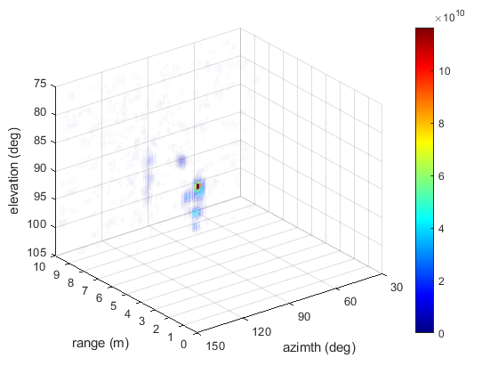
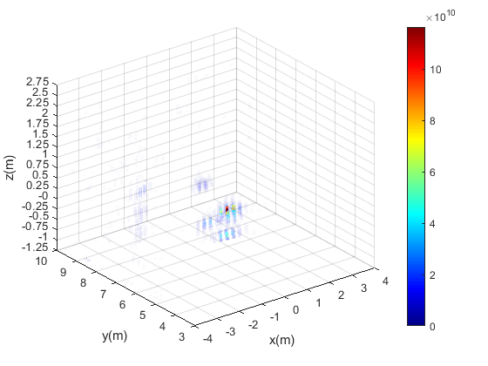
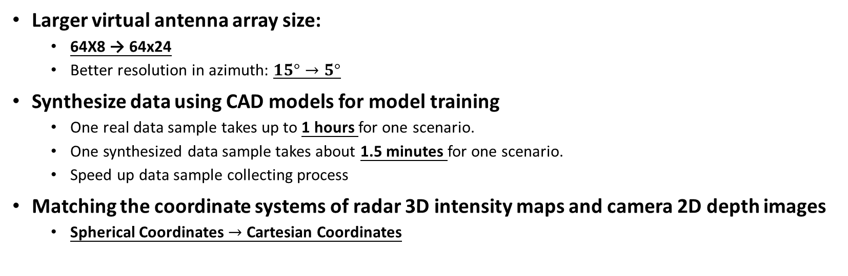
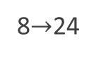
Design Improvements
Larger virtual antenna array size:
64X8 → 64x24
Better resolution in azimuth: $15°→5°$
Synthesize data using CAD models for model training
One real data sample takes up to 1 hours for one scenario.
One synthesized data sample takes about 1.5 minutes for one scenario.
Speed up data sample collecting process
Matching the coordinate systems of radar 3D intensity maps and camera 2D depth images
Spherical Coordinates $→$ Cartesian Coordinates
64
8$→$24

Slide 13
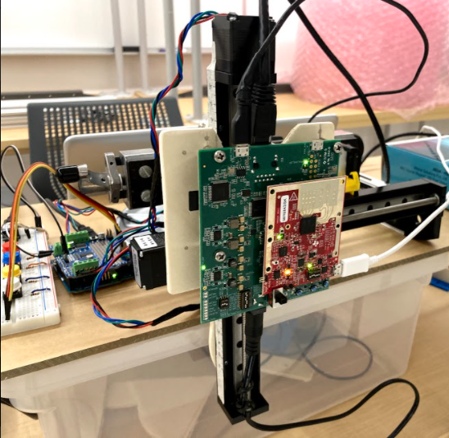
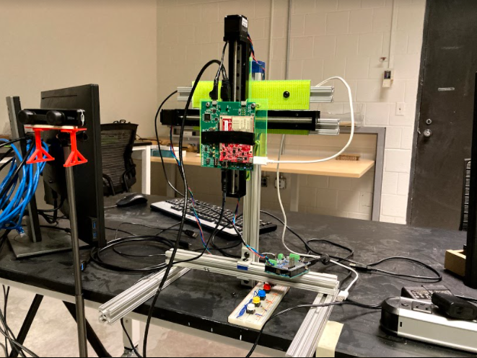
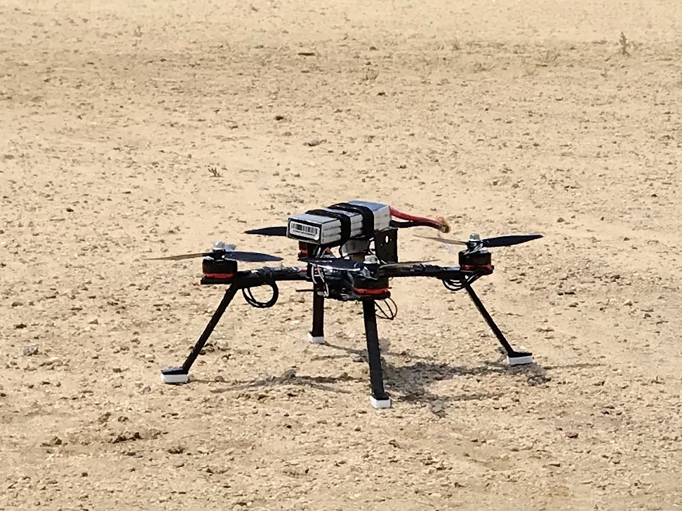
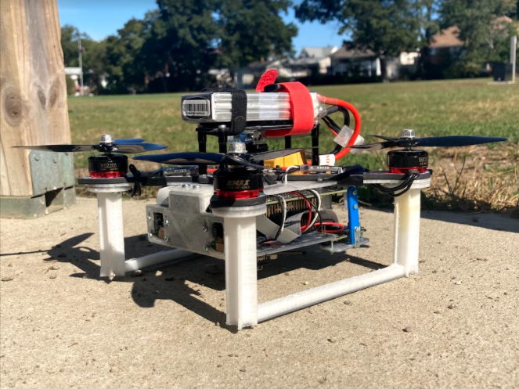
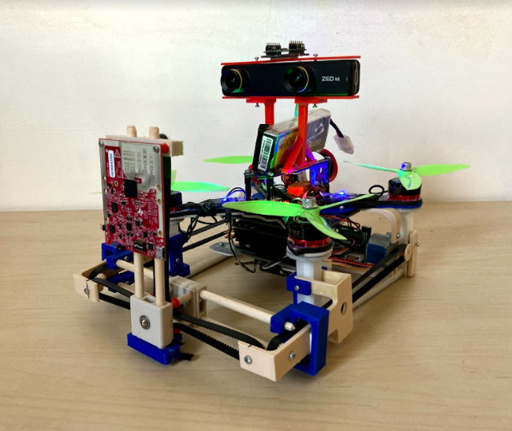
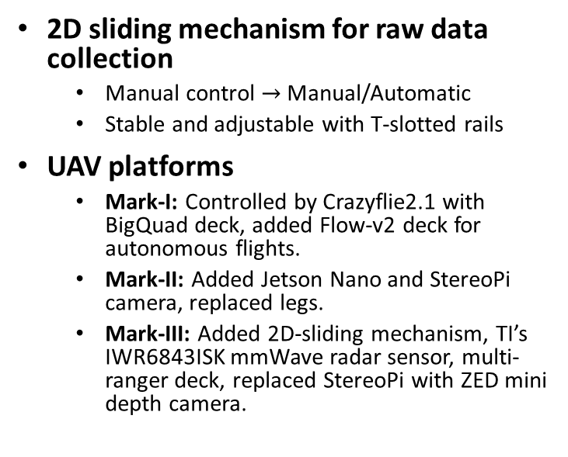
Design Improvements
2D sliding mechanism for raw data collection
Manual control $→$ Manual/Automatic
Stable and adjustable with T-slotted rails
UAV platforms
Mark-I: Controlled by Crazyflie2.1 with BigQuad deck, added Flow-v2 deck for autonomous flights.
Mark-II: Added Jetson Nano and StereoPi camera, replaced legs.
Mark-III: Added 2D-sliding mechanism, TI’s IWR6843ISK mmWave radar sensor, multi-ranger deck, replaced StereoPi with ZED mini depth camera.
Mark I (06/2020)
Mark II (08/2020)
Mark III (Developing)

Slide 14

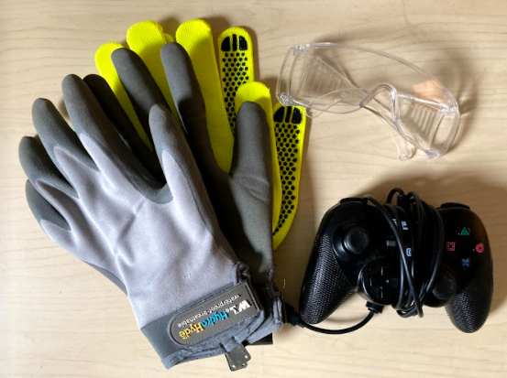
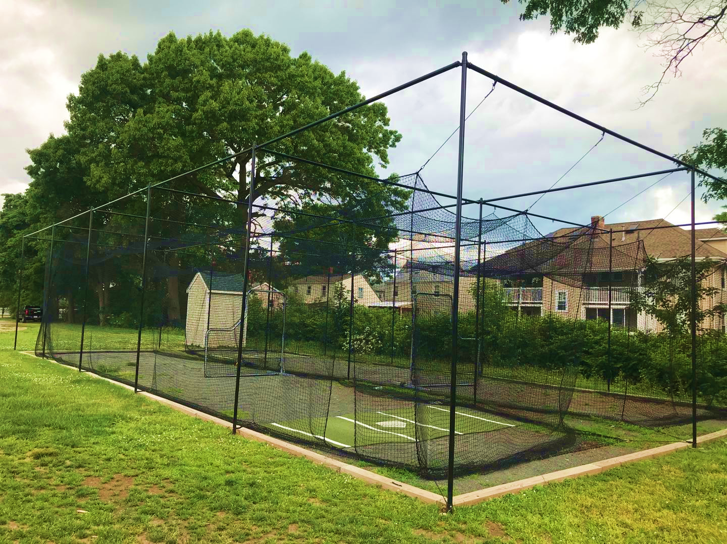
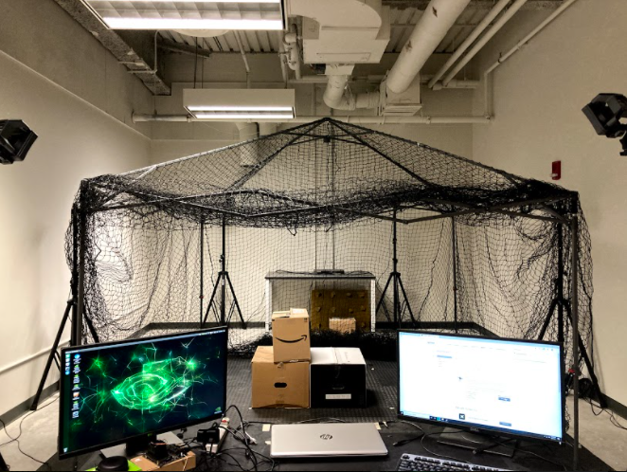
Ethical Consideration
Privacy Preserving
Ask for permission if private properties are involved.
Keep camera off when it is not necessary, or when people feel uncomfortable in front of it.
Safety Standard
UAV operators must wear protections (safety glasses, cut-resistance gloves)
Check conditions of motors, propellers, and battery before launching the UAV
Drop-in net covering the space for flight tests

Slide 15
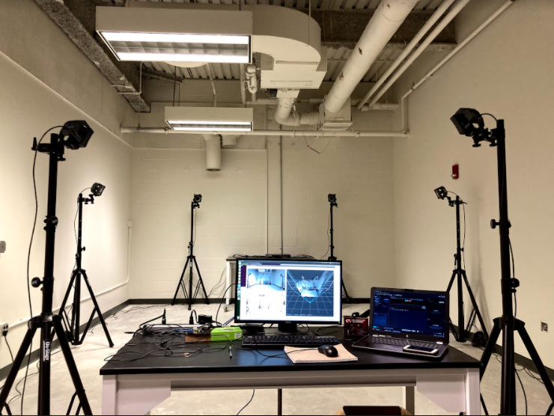
Test 1: Depth camera
Reference: OptiTrack
In a room with nonuniform light, place markers on the corners, edges, and surfaces of objects (e.g., box, desk). Capture the depth image with depth camera, and record positions of markers with OptiTrack. Measure and compare the distance from depth camera to each marker over 100 frames.
Validation
– Depth Camera
OptiTrack:
A set of fixed optical camera sensors that can provide accurate measurements with positional error < 0.3mm, and rotational error < 0.05°
*Thank Prof. Rahaim for his OptiTrack system

Slide 16
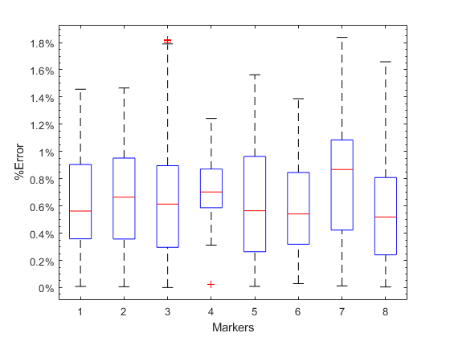
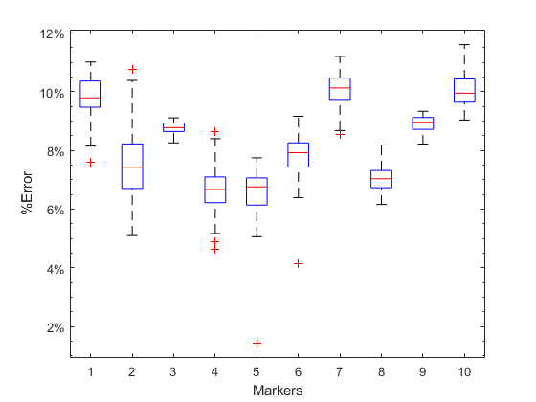
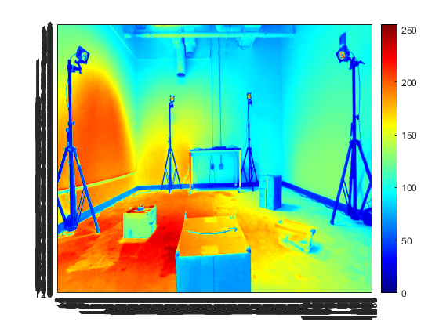
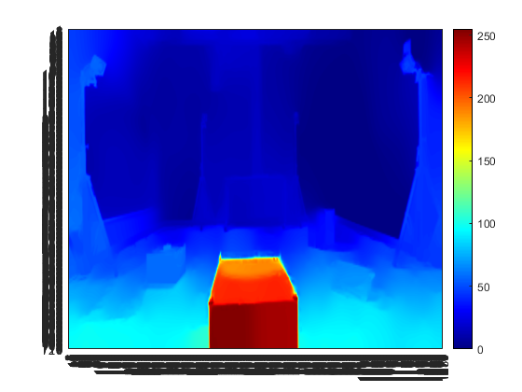
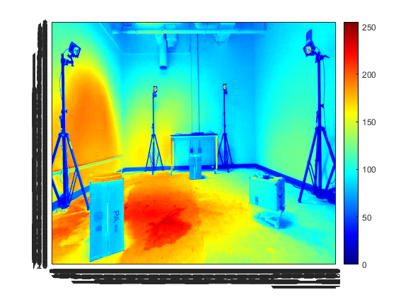
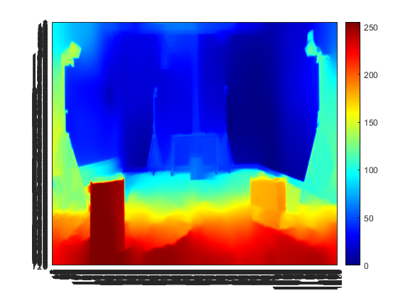
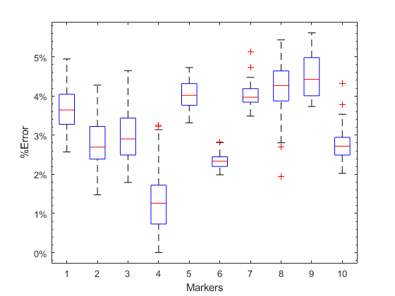
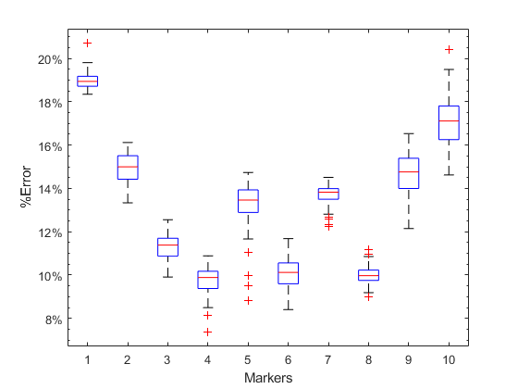
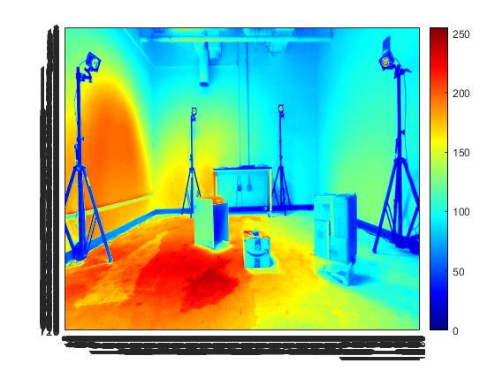
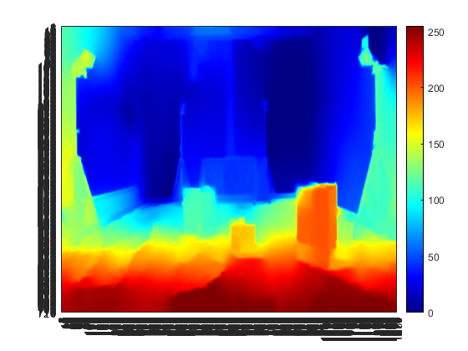
Accuracy in distance measurements
1. High brightness – High contrast
2. High brightness – Low contrast
Contrast Brightness | High | Low
High | <1.8% | <11.5%
Low | <5.6% | <21.0%
Brightness images
Depth
images
Validation Data – Depth Camera
3. Low brightness – High contrast
4. Low brightness – Low contrast

Slide 17
Test 2: mmWave Radar sensor
Reference: OptiTrack
In a room, place objects at some distance. For each object, place markers at the four corners of the surface facing towards the radar sensor. Measure and compare the distance from radar sensor to that surface over 100 frames of video/chirps of signal.
Validation
–mmWave Radar
OptiTrack:
A set of fixed optical camera sensors that can provide accurate measurements with positional error < 0.3mm, and rotational error < 0.05°
*Thank Prof. Rahaim for his OptiTrack system

Slide 18
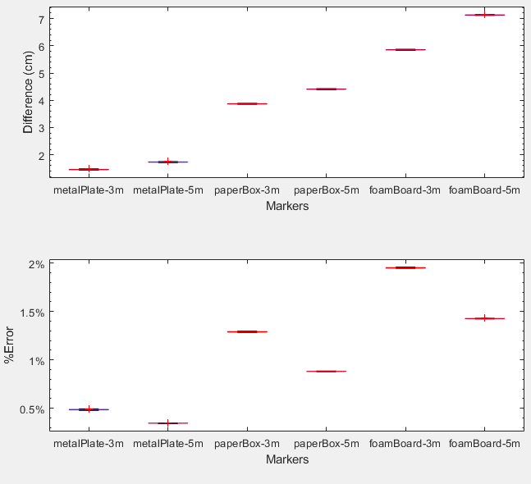
Validation Data – mmWave Radar
Antenna array size: 64 x 24
Range resolution ≅ 3.8cm
Elevation angular resolution ≅ 1.8°
Azimuth angular resolution ≅ 4.8°
Distance measurement comparison
Tested 3 materials:
Metal plate: strong reflection
Paper box: weak reflection
Foam board: multi-path reflection
 | Metal plate |  | Paper box |  | Foam board
 | Diff(cm) | Error | Diff(cm) | Error | Diff(cm) | Error
3m | 1.43 | 0.48% | 3.85 | 1.29% | 5.87 | 1.95%
5m | 1.73 | 0.34% | 4.43 | 0.88% | 7.15 | 1.42%
Angle measurement result
Azimuth | Elevation
<16.5% | <4.3%

Slide 19
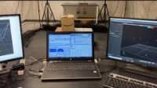
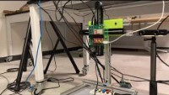
Validation & Operation
Time-lapse SAR operation
https://youtu.be/aZofhSfoh1s
https://youtu.be/5lDimbV1rhI

Slide 20
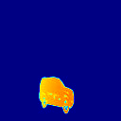
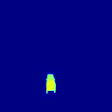
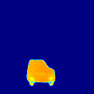
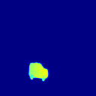
Test 3: Neural Network
Synthesized data with CAD car models [1]
Reference: Synthesized 2D depth images
Extract only 2 snapshots of synthesized radar data to generate the 3D intensity maps.
Using 2475 pairs of 3D radar intensity maps and 2D depth images to train an AI model.
Input 25 sets of 3D radar intensity maps to the model, compare the AI generated 2D depth images to synthesized 2D depth images.
Tested workflow: 2-snapshot 3D radar intensity map → 2D depth image
Train | 2475
Verify | 25
Good | 14
Acceptable | 6
Bad | 5
Examples of results:
Good
Acceptable
Bad
Validation Data – Neural Network
56%
80%
True depth images (synthesized from CAD car models[1])
Generator losses
G_GAN: | 0.693
G_L1(*1000): | 2.861
G_Lp(*20): | 21.452
Discriminator losses
D_real: | 0.440
D_fake: | 0.693
AI-generated depth images
Matched in color, size and orientation
Similar in color, size and orientation
Wrong size and orientation

Slide 21
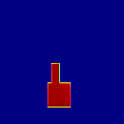





Test 3: Neural Network
L-shape boxes
Reference: Real + synthesized 2D depth images
400 real data samples + 2400 synthesized data samples
Used 2500 samples for training, 300 for verification
Tested workflow: 2-snapshot 3D radar intensity map → 2D depth image
Train | 2500
Verify | 300
Good | 125
Acceptable | 106
Bad | 69
Examples of results:
Good
Acceptable
Bad
Validation Data – Neural Network
42%
77%
True depth images
Generator losses
G_GAN: | 0.693
G_L1(*1000): | 26.244
G_Lp(*20): | 21.651
Discriminator losses
D_real: | 0.408
D_fake: | 0.694
AI-generated depth images
Matched in color, size and orientation
Similar in color, size and orientation
Wrong color, size and orientation

Slide 22
Test 4: Power supply of Drone
Run the motors under different settings of throttle, record the voltage of battery every 5 minutes.
Battery info: 11.1V, 20.0Wh, 1800mAh
Room temperature during tests: 17°C
Tested without running other devices (e.g., Jetson Nano, ZED mini camera, IWR6843ISK radar sensor)
50% Throttle
75% Throttle
100% Throttle
Validation Data – Drone
Time (min) | Battery Voltage (V)
0 | 12.53
5 | 12.46
10 | 12.35
15 | 11.72
20 | 11.15
Time (min) | Battery Voltage (V)
0 | 12.51
5 | 12.40
10 | 11.99
15 | 11.16
20 | 10.95
Time (min) | Battery Voltage (V)
0 | 12.60
5 | 11.73
10 | 11.34
15 | 11.13
20 | 9.65
Sufficient for collecting one data sample (2 snapshots, single point of view),
but insufficient for more data samples or more points of view.

Slide 23



Example Result
128x128
(size for model training)
1280x720
(original size)
Based on ZED mini configuration (pixel size, focal length, etc.)

Slide 24
Deliverables
A 3D-object reconstruction system
Goal: Generates depth images from sparse raw mmWave radar data.
Data-collecting and model-training
Raw data collecting mechanism (Fig. 1)
MATLAB program for generating 3D radar intensity images and 2D depth images.
Neural networks for training AI Models
UAV platform design
Drone with SAR mechanism holding and moving the radar sensor and depth camera (Fig. 2)
Fig. 1
Fig. 2

Slide 25
Current Status & Future Work
Higher resolution AI-generated depth images → more features for small objects
Deep Neural Network for multiple-view 3D intensity maps/2D depth images
3D-space mapping and reconstruction
Larger loads, longer flight time with bigger drone frame, more powerful motors, and higher capacity battery.
Flight stabilization through better PID tuning and balancing

Slide 26
Acknowledgement and References
Yue Sun: Building Neural Networks
Dr. Honggang Zhang: Customer mentor and technical manager
Dr. Tomas Materdey: Teaching senior design courses
Dr. Michael B. Rahaim: Providing OptiTrack system
Andrew Davis: Supplying resources
Lucas E. Lomba: Helping with drone design
[1] J. Guan, S. Madani, S. Jog, and H Hassanieh.“High Resolution Millimeter Wave Imaging for Self- Driving Cars.”. 2020. IEEE CVPR (2020).
[2] S. Fang and S. Nirjon. “SuperRF: Enhanced 3D RF Representation Using Stationary Low-Cost mmWave Radar.” 2020. International Conference on Embedded Wireless Systems and Networks (EWSN), Vol. 2020. NIH Public Access, 120.
[3] Texas-Instruments, IWR6843ISK, 2021 [Online]. Available: https://www.ti.com/tool/IWR6843ISK
[4] Texas-Instruments, DCA1000EVM, 2021 [Online]. Available: https://www.ti.com/tool/DCA1000EVM
[5] STEREOLABS, ZED mini, 2021 [Online]. Available: https://www.stereolabs.com/zed-mini/
[6] LEYARD, OptiTrack, 2021 [Online]. Available: https://optitrack.com/

Slide 27
Thank you
Question?

